Slide 1
Engineering Cycle Worksheet
Jad Isidore
2021101043

Slide 2
1 DECOMPOSE the problem
What is the problem you are solving? What smaller problems can you break it into?
Big Goal:
Print the average of three numbers.
User should be allowed to enter any three numbers.
Subgoals:
Add all three numbers then divide by 3

Slide 3
1 DECOMPOSE the problem
Based on your understanding of the problem, make an educated guess about which coding concepts you will use.
Coding concepts:
I believe that I may have to use variables and a function in this lab.

Slide 4
2 PLAN a solution
How should your algorithm solve the problem? Plan your solution in plain English or pseudocode.
First, I have to…
Establish all my variables.
Then I have to…
Prompt the user to enter any three numbers

Slide 5
2 PLAN a solution
How should your algorithm solve the problem? Plan your solution in plain English or pseudocode.
Finally, I have to…
Store the sum of all three numbers over 3 in a function, ensuring that the right operations were used to find the average

Slide 6
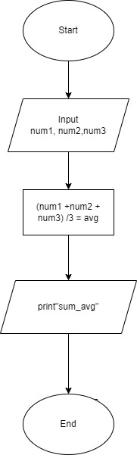
2 PLAN a solution

Slide 7
2 PLAN a solution
IPO Chart
INPUT | PROCESS | OUTPUT
num1, num2, num3 | num1+num2+num3 /3 | sum_avg()
sum_avg | avg
avg, text

Slide 8
3 IMPLEMENT the solution
2. # Info about program
print("<--This program is designed to calculate the average of any three(3) numbers.-->")
print("<--Enter any three numbers to get the average.-->")
# Prompt the user to enter three numbers
num1 = int(input("Enter first number: "))
num2 = int(input("Enter second number: "))
num3 = int(input("Enter third number: "))
1. # Declaration of variables
num1 = int
num2 = int
num3 = int
text = "Average is: “
3. # Storing sum and average into a function
def sum_avg():
avg = (num1 + num2 + num3) / 3
print(text)
print(avg)
sum_avg()

Slide 9
4 TEST and DEBUG the code
Type your code into the code editor. Hit “run” to see if your code does what you intended. Make sure to check your spelling, syntax and structure. Type ‘x’ for which happens, add additional where applies.
X | Code works as intended
X | Everything is spelled correctly
X | Lines are properly indented
X | Parentheses () are correct
X | Capitalization is correct
X | Variables are defined before I use them
X | Function works as intended

Slide 10
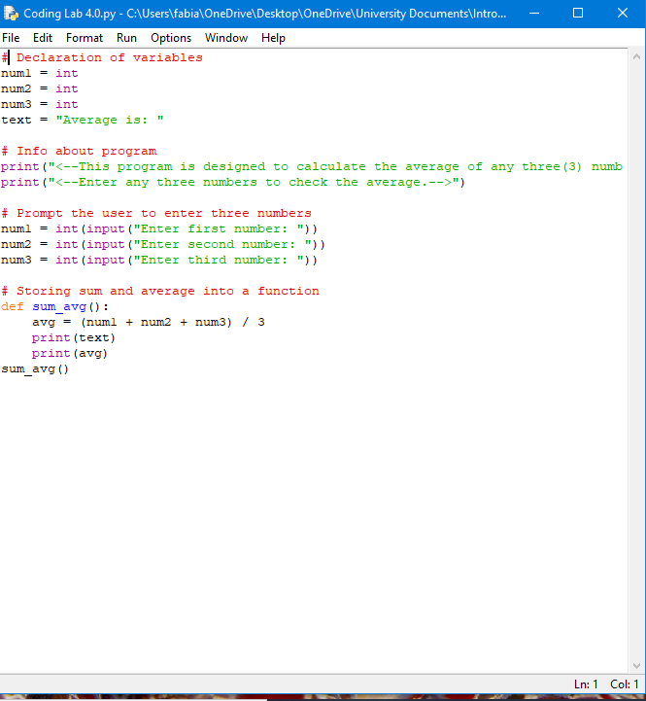
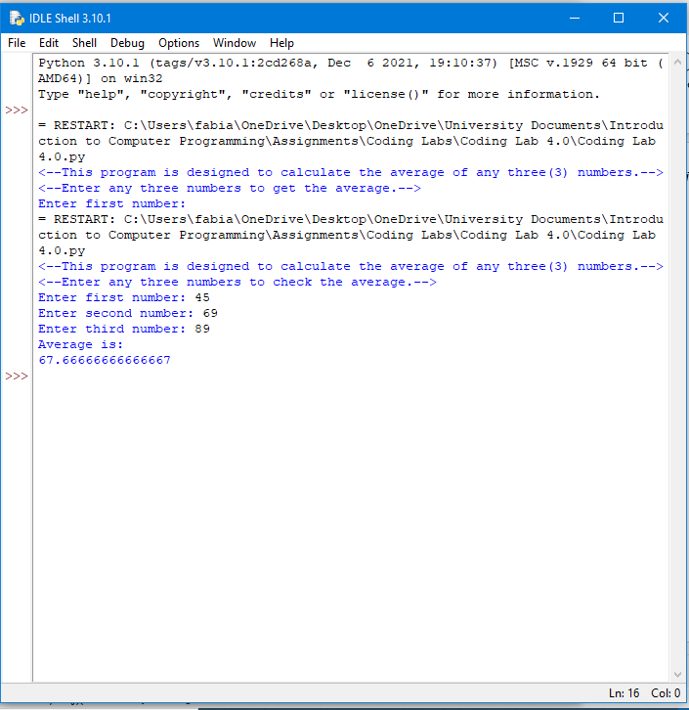
If you got no errors. Screenshot your code and the output and paste them onto this slide. If you got errors, please advance to the next slide

Slide 11
If you got errors. Screenshot your code and the error you got and paste them onto this slide.

Slide 12
What caused the error?

Slide 13
Screenshot the newly adjusted code and its output.

